Slide 1
ES 117: World of Engineering
Conceptualization

Slide 2
Broad Problem Statement
Helping the differently-abled (mute or blind) people to navigate the world.
Blind people need external aid to navigate the world. They face challenges accessing and reading standard printed text.
Facilitating effective two-way communication between mute and deaf individuals presents a significant societal challenge.

Slide 3
Specific Problem Statement
Blind and deaf individuals face significant challenges in accessing textual material, thereby limiting their ability to engage with written information and participate fully in various aspects of life.
The current lack of inclusive technologies and resources prevents these individuals from effectively engaging with textual information, hindering their educational and professional opportunities.
They face challenges accessing Braille boards, because feasibility of making braille boards for different written materials is very low and inefficient.

Slide 4
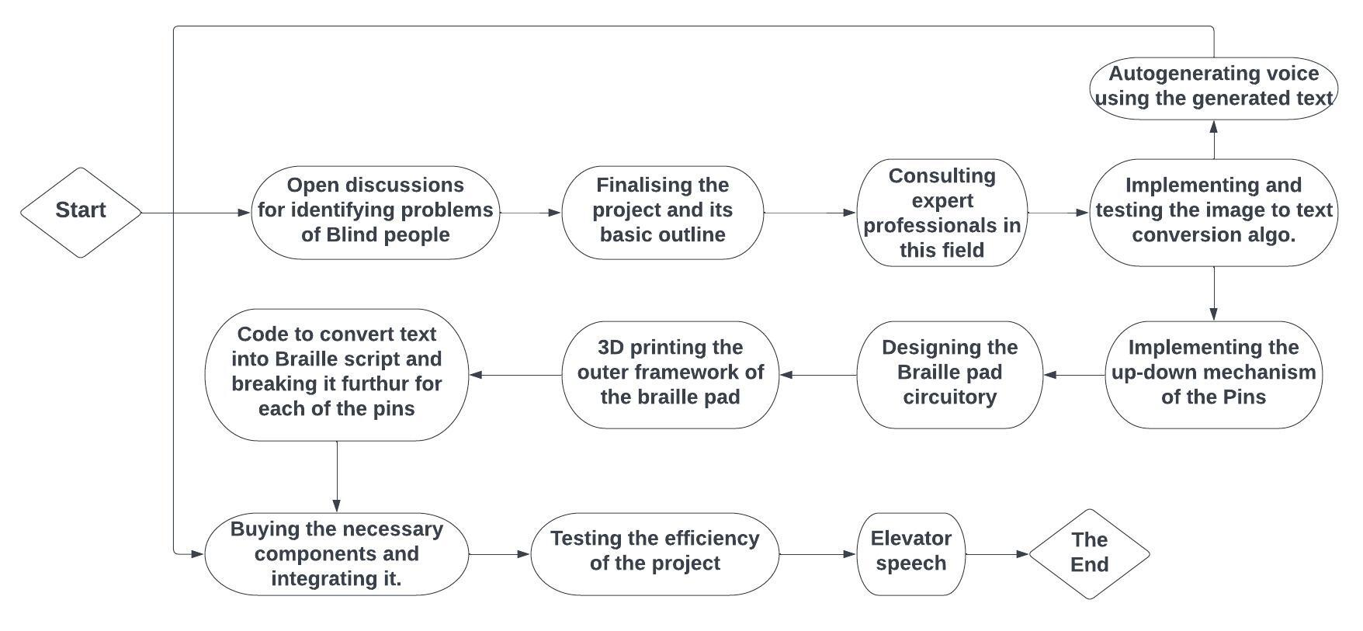
Flowchart of Workflow and Concept

Slide 5
Calculations and Quantifications
Camera resolution:- 1920×1080p
Imaging range:- IR vision with a large range
Dimensions of Braille pad:- 40×30×25 cm³
Field of view of the head camera:- Around 150°
Space consumed by each pin:- 10 mm²
Battery Power Rating:- 300 mAh
Braille translation accuracy:- 90-95%
Refresh rate:- Around 30 fps or 60 fps
Cost analysis:- Around ₹8000

Slide 6
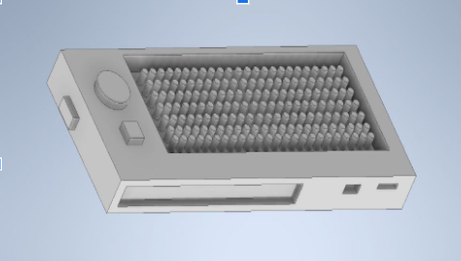
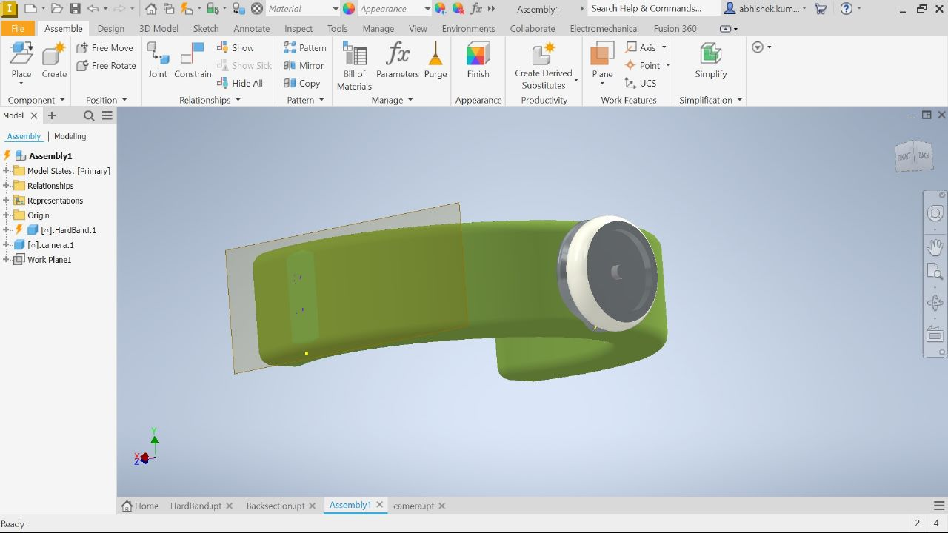
Autodesk Models/Conceptual Diagrams
Figure: Autodesk Model of Braille Pad
Figure: Autodesk Model of Head Camera

Slide 7
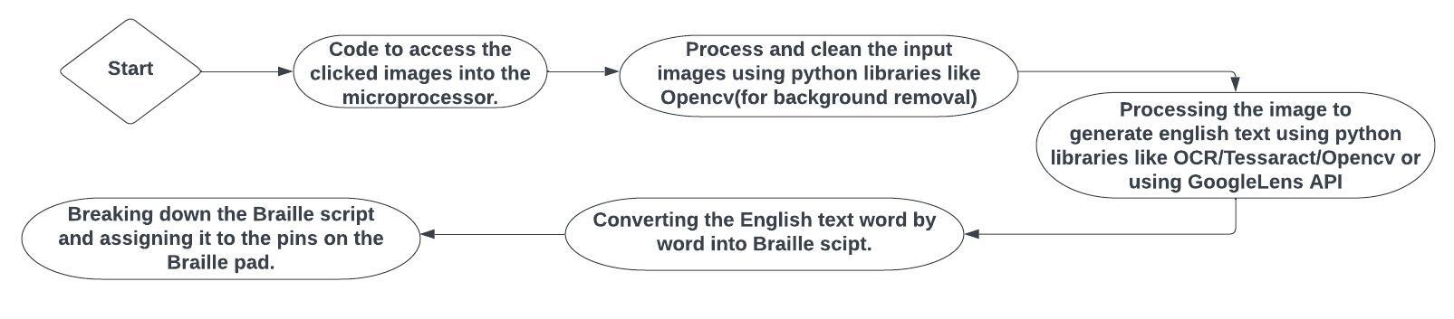
Flowchart of Algorithms Involved

Slide 8
References
[1] R. Sarkar and S. Das, “Analysis of Different Braille Devices for Implementing a Cost-effective and Portable Braille System for the Visually Impaired People,” Int. J. Comput. Appl., vol. 60, no. 9, pp. 1–5, 2012, doi: 10.5120/9717-3073.
[2] https://www.amazon.in/Spy-Cameras/b?ie=UTF8&node=138920703.
[3] S. Supriya and A. Senthilkumar, “Electronic Braille pad,” IEEE Xplore, Jun. 01, 2009. Link (accessed Jun. 02, 2023).
‌
‌

Slide 9
References
[4] J. L. Dela Cruz, J. A. D. Ebreo, R. A. J. P. Inovejas, A. R. C. Medrano, and A. A. Bandala, “Development of a text to braille interpreter for printed documents through optical image processing,” IEEE Xplore, Dec. 01, 2017. https://ieeexplore.ieee.org/abstract/document/8269523 (accessed Jun. 01, 2023).

